Slide 1
C851 SPECIAL EDITION: Your New Course & Labs
C851 Cohort Live Session for Sunday, September 19, 2021
Dr. John S. Galliano | C851 Linux Foundations Instructor

Slide 2
Agenda
Welcome
Upgraded C851
Format Comparison
The New Labs
Demos
About the Exam
The 5 Exam Domains
Wrap-Up

Slide 3
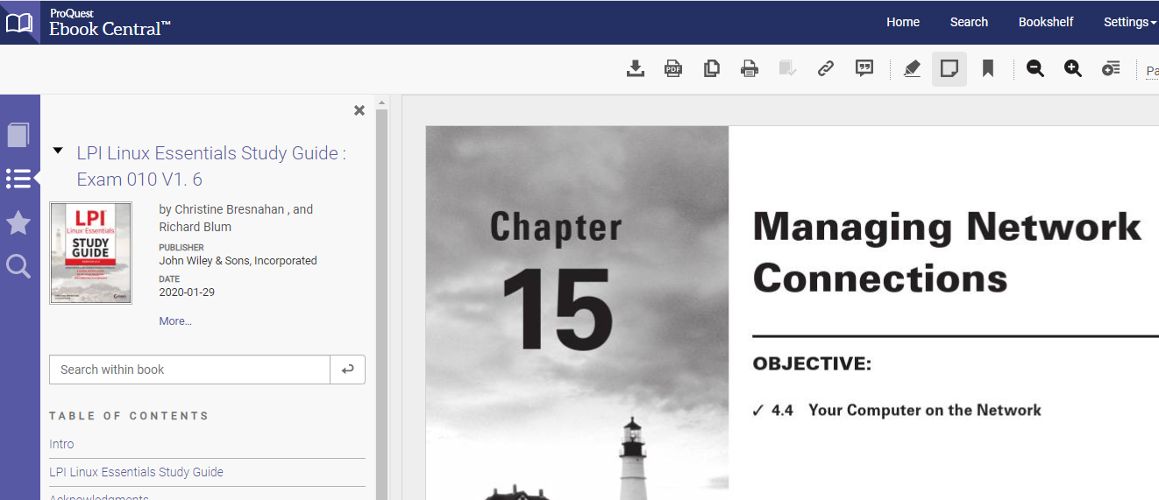
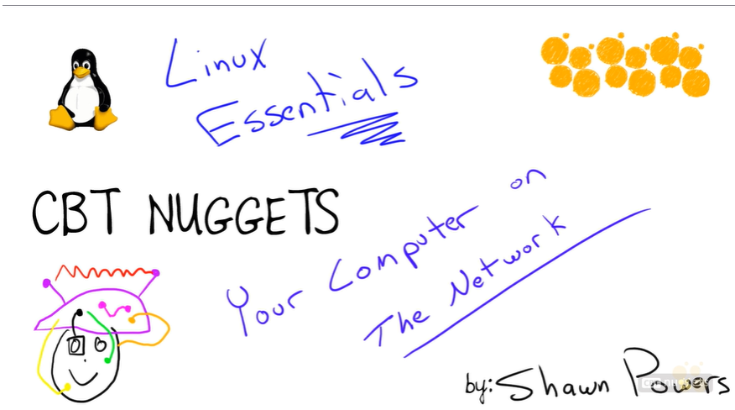
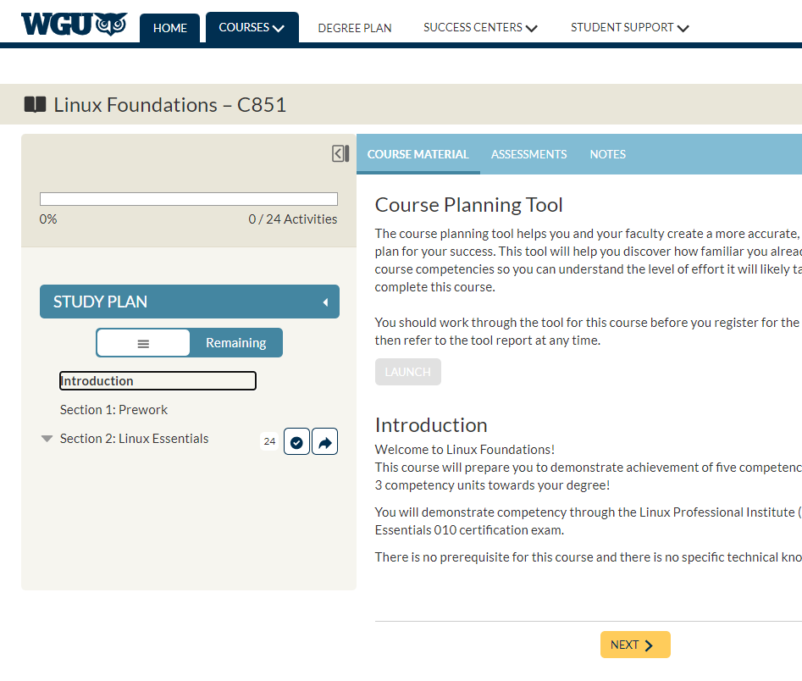
C851 v4 Upgraded Course Experience
C851 gets an UPGRADE!
Refreshed course site launches on 9/23
Content remains the same but new labs built on RHEL
New delivery via CBTnuggets and the Sybex LPI Linux Essentials prep guide
You are encouraged to install your own VM by following along at: https://bit.ly/create_vm
Notes:
Create your own VM Using Kali Linux: https://bit.ly/create_vm

Slide 4
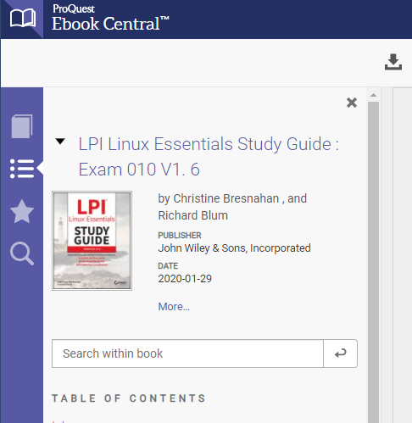
Content Comparison (The New COS…) – Part 1
Same as previous COS (uCertify based on Sybex eBook)
Study material in the “Lesson and Knowledge Check”
A preassessment test available in the eBook “Assessment” tab and “Answers to Assessment Test” tab)
uCertify used Quizzes, new COS has Review Questions at the end of each Chapter (answers in the Appendix)
Has a section namely “Exam Essentials” at the end of each Chapter (excellent topics summary to ace the exam)
Can be downloaded as a PDF using the link at the top right-hand corner in the Course Landing page “Download Course as PDF”

Slide 5
Content Comparison (The New COS…) – Part 2
For practice tests, use:
Jason Dion’s Udemy courses (2+6) for 8 total practice tests (I highly recommended that you do all the Practice Exams)
Available at https://lrps.wgu.edu/provision/256189525
Complete the 2 Practice Tests by Jason Dion “LPI Linux Essentials (010-160) Complete Course and Exams”
Also search for " LPI Linux Essentials 010-160 (6 Practice Exams) " by Jason Dion
For content videos use:
Udemy video “LPI Linux Essentials (010-160) Complete Course and Exams” by Jason Dion
CBT nugget videos
Linked in videos
To use a mobile device to view the COS:
Use the following link and try to download each chapter of the eBook from the web https://ebookcentral.proquest.com/lib/westerngovernors-ebooks/detail.action?docID=6002518
The above link works well on iPads

Slide 6
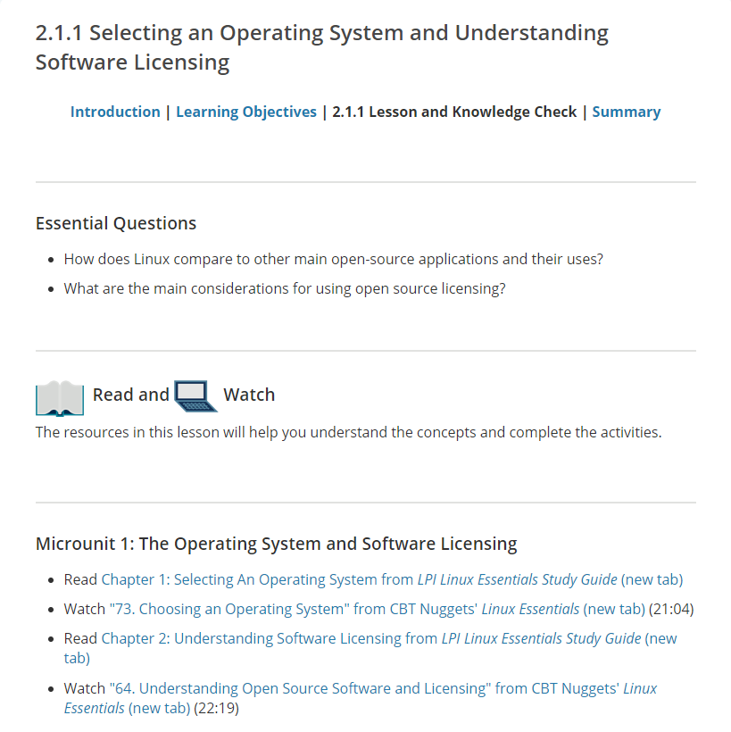
The New COS Flow
Each subsection has a page
Each page has learning objectives (essential questions)
Each page directs you to the best resource to learn that topic
Each page has from 1-3 knowledge check questions
PRO Tip: Do NOT rely on the knowledge check questions to gauge your readiness for the exam!

Slide 7
Content Comparison (The New COS…) – Part 3
BIG advantage of the new COS is the extensive lab exercises with built-in, stable lab environment
OA requires that we are proficient in using the CLI
You can save the lab session after every use
If you have difficulty accessing labs, use the ‘Help’ tab at the top right-hand corner of the lab window to chat with a live agent
Please refer the following pdf file for step-by-step instruction to login and use the built-in lab available with the new COS
https://srm--c.na127.visual.force.com/apex/coursearticle?Id=kA03x0000015NlZCAU
PRO Tip: As you study each chapter, practice the lab simultaneously for optimal learning.

Slide 8

New Labs - Background
Based on Red Hat Enterprise Linux (RHEL)
Oracle Linux is an open-source clone
Did You Know? Oracle’s Linux distro is a clone of RHEL and used in the Oracle Cloud Infrastructure (OCI).

Slide 9
New Labs – What’s Covered?
Lab 1 : Fundamentals of Open-Source Software
01 list major distributions
02 clarify how the "open source" philosophy influenced Linux and its licensing
03 identify major open-source applications and their uses
04 list uses of Linux
05 describe cloud technology in a Linux environment
Lab 2 : Command Line Basics
01 execute commands for various help systems
02 manage home and system directories
03 list files and directories attributes in various locations
04 manage files in various directories on the system
Lab 3 : Advanced Commands - Part 1
01 execute commands to handle archive files
02 apply basic regular expressions
03 execute commands to search for files
04 execute commands to extract data from files

Slide 10
New Labs – What’s Covered?
Lab 3 : Advanced Commands - Part 2
05 Execute commands to manipulate output
06 Differentiate between multiple output commands
07 Manage command input and output with redirection operators and pipes
08 Execute commands to handle compressed files
09 Differentiate between text editors, vim and nano
Lab 3 : Advanced Commands - Part 3
10 Apply scripting syntax
11 Differentiate and use variables within scripts
12 Differentiate the use of loops in performing repetitive tasks
13 Execute commands to display output and exit status
Lab 4: Distributions, Features, and Requirements
01 differentiate between major operating systems
02 identify req’d life cycle management elements for major operating systems
03 differentiate reasons for using graphical user interface (GUI) and CLI
04 list computer hardware for desktop and servers
05 identify different types of computer storage
06 differentiate between partitions, their naming conventions, and their uses
07 identify basic attributes of running programs

Slide 11
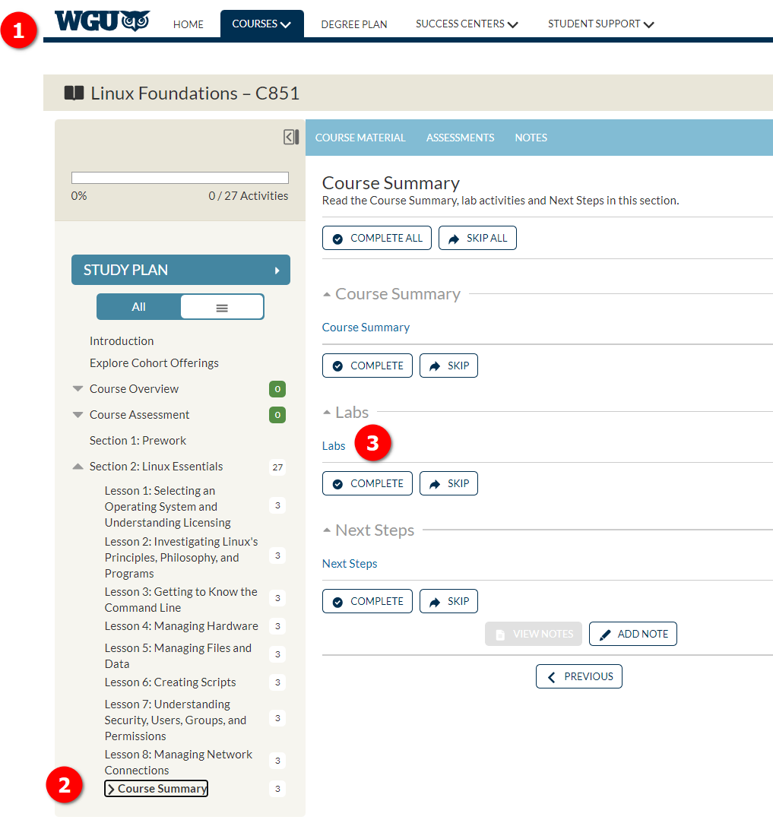
New Labs – Logging-In
Go to your course landing page
Click-on ‘Course Summary’
Click-on the ‘Labs’ link
PRO Tip: The new labs provide a deeper Linux command line experience. Feel free to do the labs multiple times.

Slide 12
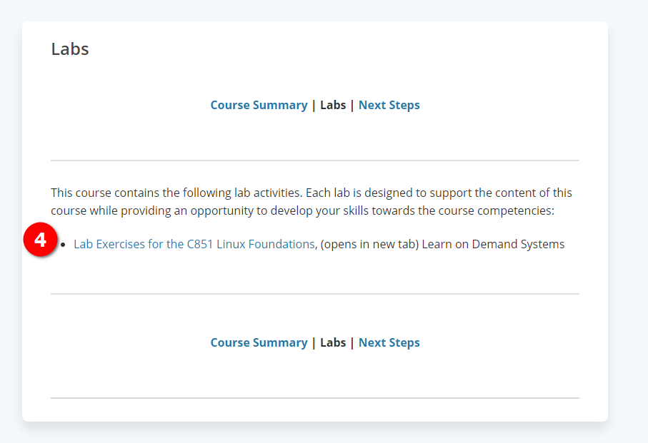
New Labs – Into the LODS
You will land on a ‘helper’ page
Click-on ‘Lab Exercises for the C851 Linux Foundations’
PRO Tip: You can ‘bookmark’ the landing page and name it C851 Labs, for easy reference.

Slide 13
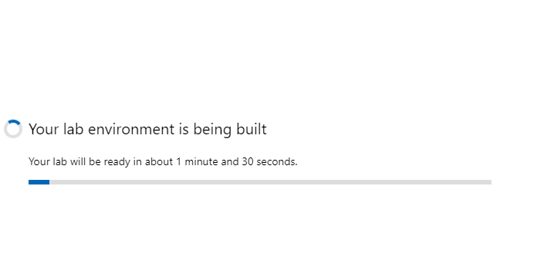
New Labs – The Lab Interface
You will authenticate through to the LODS virtualized labs platform
LODS will give you an indication of the load time
PRO Tip: The labs are responsive but may require some spin-up time to allocate resources.

Slide 14
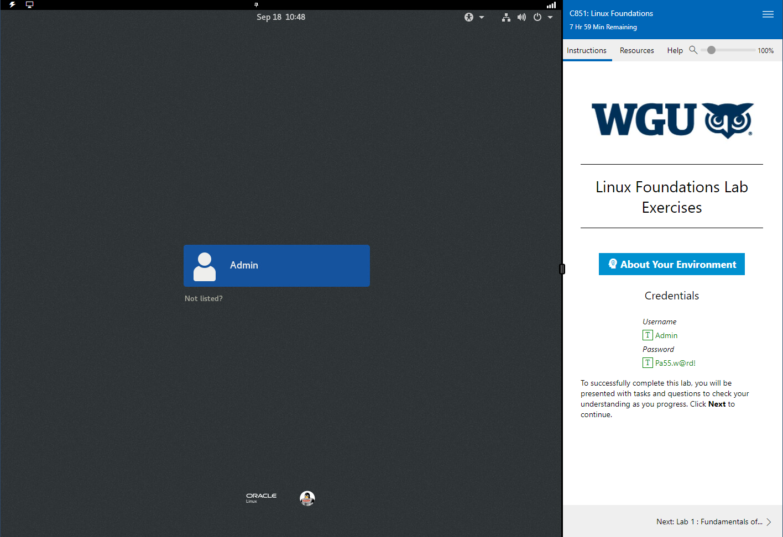
New Labs – The Lab Interface
You will see the Oracle Linux VM login screen, defaulted to the Admin account
Look for the WGU logo on the right
Note the creds and the green “T” icons
Clicking the “T” will send the text to your lab instance (very handy!)
In the bottom right you will see a navigation arrow to the next item
PRO Tip: Try and do you labs on a nice, big monitor. While doable on a laptop the extra screen real estate helps.

Slide 15
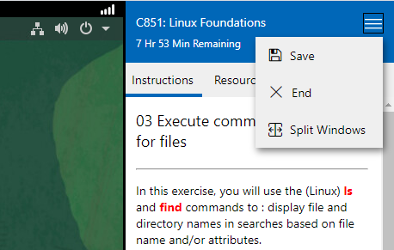
New Labs – The Lab Interface
Clicking the hamburger menu in the upper right allows you to save and end your lab
You can also start “split windows”
PRO Tip: The ‘Save’ function preserves your lab for 14 days -- an easy way to start where you left off.

Slide 16
Time Limits, Saving, Extensions, Completions
You are allotted 1 hour of lab access once you start a lab
You can extend if needed:
Watch for the prompt to extend within 15- 30 mins remaining
Each extension adds 15 minutes
There are 2 ways your lab can be ERASED and not recoverable
When prompted to extend, you choose no,
You saved a lab (for 14 days) but do not resume in that period
If you resume that lab within 14 days, your access remains
If you save the lab again, remains for an additional 14 days
Successful lab completion means you complete all of the requirements in a page and navigate by clicking the nav arrow at the bottom of a pane
PRO Tip: Complete the exercises in order since later labs may rely on successful completion of previous tasks!

Slide 17
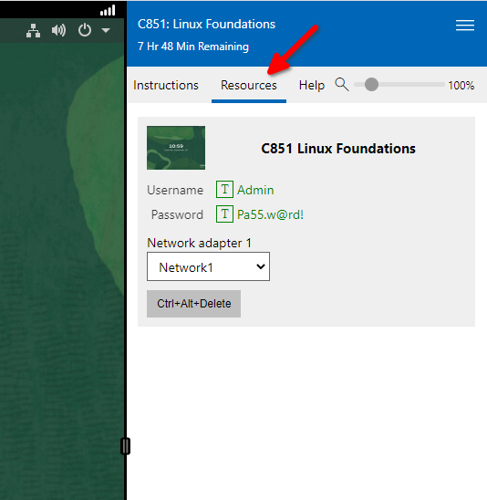
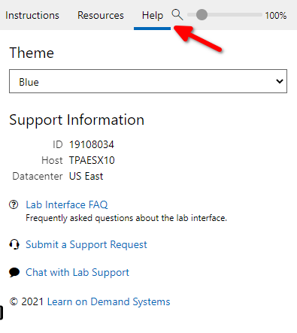
Tabs
On the ‘Instructions’ tab are the steps you take to complete the lab
On the ‘resources’ tab, you will find:
available VMs
Creds
Network adapters
A handy “Ctrl+Alt+Del” button
On the ‘Help’ tab, you will find support links
PRO Tip: I’ve found the LODS chat function very responsive and the quickest way to resolve issues.

Slide 18

DEMOS
How to log into the lab environment
How to save the lab session and exit
How to power down the lab session
PRO Tip: Refer to https://srm--c.na127.visual.force.com/apex/coursearticle?Id=kA03x0000015NlZCAU for step-by-step instructions.

Slide 19

About the Linux Essentials v1.6 [1]
The 5 Exam Domains [3]
No prerequisites
Closed book, up to 60 minutes
40 multiple-choice (some multi-select and fill-in-the-blank items) questions
Min pass score 500 points (200-800 scale)
Partially correct responses not accepted (for F-I-T-B questions LPI may accept multiple correct versions of an answer [2]
Total exam weight count is 40, thus 40 questions
The Linux Community and a Career in Open Source
Finding Your Way on a Linux System
The Power of the Command Line
The Linux Operating System
Security and File Permissions
[1,3] Linux Professional Institute, “Linux Professional Institute Linux Essentials,” Linux Professional Institute, 21-Oct-2018. [Online]. Available: https://www.lpi.org/our-certifications/linux-essentials-overview. [Accessed: 14-Aug-2021]
[2] Dr. Galliano’s correspondence with LPI, dated August 2021: Example: with/without leading path in a case where the answer is a command
Notes:
Example: If an objective has a weight of 4, there will be 4 questions on the exam related to that objective [2]
Link: View the 3rd party cert tips video at https://bit.ly/3party_cert_tips

Slide 20

LPI Exam Re-Take Policy [4]
Anyone who takes an LPI exam once must wait one week before re-taking
Anyone who takes an LPI exam a second (and subsequent) time must wait 30 days before re-taking
3rd and subsequent attempts are at your own cost ($120)
[4] Linux Professional Institute, “Privacy Statement and Policies,” Linux Professional Institute, 18-May-2018. [Online]. Available: https://www.lpi.org/policies. [Accessed: 14-Aug-2021].
Notes:
• Anyone who passes an LPI exam may not retake that exam for two years

Slide 21

Exam Topics/Weightings
Linux Essentials v1.6 Exam Topics [5] | 1.1 | 2
 | 1.2 | 2
 | 1.3 | 1
 | 1.4 | 2
 | 2.1 | 3
 | 2.2 | 2
 | 2.3 | 2
 | 2.4 | 2
 | 3.1 | 2
 | 3.2 | 3
 | 3.3 | 4
 | 4.1 | 1
 | 4.2 | 2
 | 4.3 | 3
 | 4.4 | 2
 | 5.1 | 2
 | 5.2 | 2
 | 5.3 | 2
 | 5.4 | 1
 |  | 40
[5] Linux Professional Institute, “Linux Essentials Objectives V1.6 - LPI Wiki,” Linux Professional Institute, 25-Jan-2020. [Online]. Available: https://wiki.lpi.org/wiki/Linux_Essentials_Objectives_V1.6. [Accessed: 14-Aug-2021].
Notes:
• A weight of “1” equates to 1 exam question
• Since there is a weight of ‘3’, you will see 3 questions on searching and extracting data from files!

Slide 22
What Questions Do you Have for Me?

